Slide 1

Intrusion Detection Systems and Network Security
Chapter 13

Slide 2
Objectives
Apply the appropriate network tools to facilitate network security.
Determine the appropriate use of tools to facilitate network security.
Apply host-based security applications.

Slide 3
Key Terms
Analysis engine
Anomaly detection model
Banner grabbing
Content-based signature
Context-based signature
Digital sandbox
False negative
False positive
Honeynet
Honeypot
Host-based IDS (HIDS)
Intrusion detection system (IDS)
Notes:
Analysis engine – Examines the collected network traffic and compares it to known patterns of suspicious or malicious activity stored in the signature database. The analysis engine is the “brains” of the IDS.
Anomaly detection model – An IDS model where the IDS must know what “normal” behavior on the host or network being protected really is. Once the “normal” behavior baseline is established, the IDS can then go to work identifying deviations from the norm, which are further scrutinized to determine whether or not that activity is malicious.
Banner grabbing – A technique used to gather information from a service that publicizes information via a banner.
Content-based signature – Signatures that are designed to examine the content of such things as network packets or log entries. Content-based signatures are typically easy to build and look for simple things, such as a certain string of characters or a certain flag set in a TCP packet.
Context-based signature – Signatures that are designed to match large patterns of activity and examine how certain types of activity fit into the other activities going on around them. Context signatures generally address the question: How does this event compare to other events that have already happened or might happen in the near future? Context-based signatures are more difficult to analyze and take more resources to match, as the IDS must be able to “remember” past events to match certain context signatures.
Digital sandbox – The isolation of a program and its supporting elements from common operating system functions.
False negative – Term used when a system makes an error and misses reporting the existence of an item that should have been detected.
False positive – Term used when a security system makes an error and incorrectly reports the existence of a searched-for object. Examples include an intrusion detection system that misidentifies benign traffic as hostile, an antivirus program that reports the existence of a virus in software that actually is not infected, or a biometric system that allows access to a system to an unauthorized individual.
Honeynet – A network version of a honeypot, or a set of honeypots networked together.
Honeypot – A computer system or portion of a network that has been set up to attract potential intruders, in the hope that they will leave the other systems alone. Since there are no legitimate users of this system, any attempt to access it is an indication of unauthorized activity and provides an easy mechanism to spot attacks.
Host-based IDS (HIDS) – A system that looks for computer intrusions by monitoring activity on one or more individual PCs or servers.
Intrusion detection system (IDS) – A system to identify suspicious, malicious, or undesirable activity that indicates a breach in computer security.

Slide 4
Key Terms (continued)
Intrusion prevention system (IPS)
Misuse detection model
Network tap
Network-based IDS (NIDS)
Perimeter security
Port mirroring
Protocol analyzer
Signature database
Snort
Suricata
Switched Port Analyzer (SPAN)
Traffic collector
User interface and reporting
Notes:
Intrusion prevention system (IPS) – A system to identify suspicious, malicious, or undesirable activity that indicates a breach in computer security and respond automatically without specific human interaction.
Misuse detection model – An IDS model where the IDS looks for suspicious activity or activity that violates specific policies and then reacts as it has been programmed to do. This reaction can be an alarm, e-mail, router reconfiguration, or TCP reset message. Network tap – A connection to a network that allows sampling, duplication, and collection of traffic. Network-based IDS (NIDS) – A system for examining network traffic to identify suspicious, malicious, or undesirable behavior.
Perimeter security – A technique where more and more companies operate their computer security like a castle or military base, with attention and effort focused on securing and controlling the ways in and out—the idea being that if you could restrict and control access at the perimeter, you didn’t have to worry as much about activity inside the organization. Port mirroring – A technique where a mirrored port will see all the traffic passing through the switch or through a specific VLAN(s), or all the traffic passing through other specific switch ports. The network traffic is essentially copied (or mirrored) to a specific port, which can then support a protocol analyzer.
Protocol analyzer – A tool used by network personnel to identify packets and header information during network transit. The primary use is in troubleshooting network communication issues.
Signature database – A collection of activity patterns that have already been identified and categorized and that typically indicate suspicious or malicious activity.
Snort – The de facto standard IDS engine since its creation in 1998. It has a large user base and set the standard for many IDS element, including rule sets and formats. Snort rules are the list of activities that Snort will alert on and provide the flexible power behind the IDS platform. Snort rule sets are updated by a large active community as well as Sourcefire Vulnerability Research Team, the company behind Snort. Snort VRT rule sets are available to subscribers and provide such elements as same-day protection for items such as Microsoft patch Tuesday vulnerabilities. These rules are moved to the open community after 30 days.
Suricata – An open source IDS, begun with grant money from the U.S. government and maintained by the Open Source Security Foundation (OSIF). Suricata has one advantage over Snort: it supports multithreading.
Switched Port Analyzer (SPAN) – A technology employed that can duplicate individual channels crossing a switch to another circuit.
Traffic collector – Collects activity/events for the IDS to examine. On a HIDS, this could be log files, audit logs, or traffic coming to or leaving a specific system. On a NIDS, this is typically a mechanism for copying traffic off the network link—basically functioning as a sniffer. This component is often referred to as a sensor.
User interface and reporting – Interfaces with the human element, providing alerts when appropriate and giving the user a means to interact with and operate the IDS.

Slide 5
Introduction
An intrusion detection system (IDS) is a security system that detects inappropriate or malicious activity on a computer or network.
The foundation for a layered network security approach usually starts with a well-secured system.
Some of the more complicated and interesting types of network/data security devices are IDSs.
Notes:
Most organizations use their own approaches to network security, choosing the layers that make sense for them after they weigh risks, potentials for loss, costs, and manpower requirements. The foundation for a layered network security approach usually starts with a well-secured system, regardless of the system’s function (whether it’s a user PC or a corporate e-mail server).
A well-secured system uses up-to-date application and operating system patches, requires well-chosen passwords, runs the minimum number of services necessary, and restricts access to available services. On top of that foundation, you can add layers of protective measures such as antivirus products, firewalls, sniffers, and IDSs.
The main purpose of an IDS is to identify suspicious or malicious activity, note activity that deviates from normal behavior, catalog and classify the activity, and, if possible, respond to the activity.

Slide 6
History of Intrusion Detection Systems
The IDS concept came from U.S. Department of Defense–sponsored research.
Early 1970s: U.S. government and military became increasingly aware of the need to protect the electronic networks that were becoming critical to daily operations.
Continued research led to projects such as Discovery, Haystack, Multics Intrusion Detection and Alerting System (MIDAS), and Network Audit Director and Intrusion Reporter (NADIR).

Slide 7
History of Intrusion Detection Systems (continued)
1989: Haystack Labs released Stalker
Stalker was the first commercial IDS.
In the early to mid-1990s, computer systems grew.
Companies started to realize the importance of IDSs.
IDS solutions were host-based and required a great deal of time and money to manage and operate effectively.
Focus began to shift away from host-based systems, and network-based IDSs began to emerge.
Notes:
Stalker was host-based and worked by comparing audit data to known patterns of suspicious activity. While the military and government embraced the concept, the commercial world was very slow to adopt IDS products, and it was several years before other commercial products began to emerge.
NetRanger was designed to monitor network links and the traffic moving across the links to identify misuse as well as suspicious and malicious activity.

Slide 8
History of Intrusion Detection Systems (continued)
1995: WheelGroup developed NetRanger.
NetRanger was the first commercial network-based IDS product.
1996: Internet Security Systems released RealSecure.
February 1998: Cisco Systems acquired WheelGroup.
IDSs were recognized as a vital part of any network security infrastructure.

Slide 9
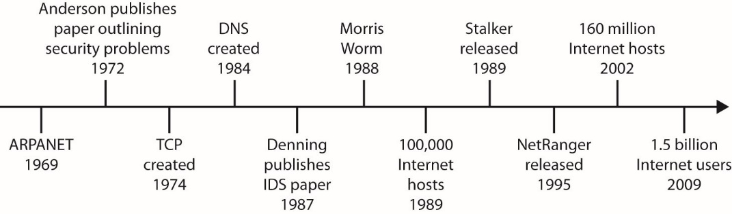
Figure 13.1 History of the Internet and IDS

Slide 10
IDS Overview
IDSs are typically divided into two main categories depending on how they monitor activity.
Host-based IDS (HIDS)
Examines activity on an individual system.
Concerned with an individual system.
Network-based IDS (NIDS)
NIDS examines activity on the network itself.
It has visibility only into the traffic crossing the network link it is monitoring and typically has no idea of what is happening on individual systems.

Slide 11
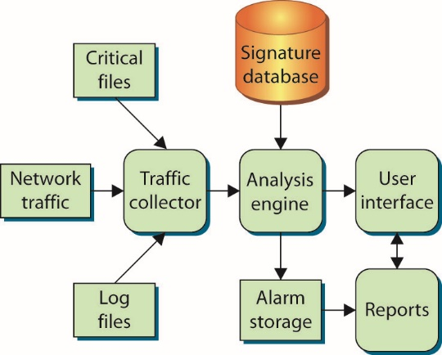
Figure 13.2 Logical depiction of IDS components
Notes:
Whether it is network- or host-based, an IDS typically consists of several specialized components working together, as illustrated in this figure. These components are often logical and software-based rather than physical and will vary slightly from vendor to vendor and product to product.

Slide 12
IDS Overview (continued)
An IDS has the following logical components:
Traffic collector (or sensor) – collects activity/events for the IDS to examine.
Analysis engine – examines the collected network traffic and compares it to known patterns of suspicious or malicious activity
Signature database – a collection of patterns and definitions of known suspicious or malicious activity
User interface and reporting – interfaces with the human element and provide alerts when appropriate
Notes:
Typically, an IDS has the following logical components:
Traffic collector (or sensor) Collects activity/events for the IDS to examine. On a HIDS, this could be log files, audit logs, or traffic coming to or leaving a specific system. On a NIDS, this is typically a mechanism for copying traffic off the network link—basically functioning as a sniffer. This component is often referred to as a sensor.
Analysis engine Examines the collected network traffic and compares it to known patterns of suspicious or malicious activity stored in the signature database. The analysis engine is the “brains” of the IDS.
Signature database A collection of patterns and definitions of known suspicious or malicious activity.
User interface and reporting Interfaces with the human element, providing alerts when appropriate and giving the user a means to interact with and operate the IDS.
In addition to the network versus host distinction, some IDS vendors will further categorize an IDS based on how it performs the detection of suspicious or malicious traffic.

Slide 13
IDS Models
IDSs are classified by the detection model used: anomaly or misuse.
Anomaly detection model is the more complicated of the two.
Identifies “normal” behavior on protected host or network
IDS identifies deviations from the norm; IDS further scrutinizes to determine if malicious activity
Building profile of normal activity done by the IDS
Allows system to deal with variations in traffic
Not restricted to a specific signature set
Notes:
An anomaly detection model is the more complicated of the two. In this model, the IDS must know what “normal” behavior on the host or network being protected really is. Once the “normal” behavior baseline is established, the IDS can then go to work identifying deviations from the norm, which are further scrutinized to determine whether or not that activity is malicious. Building the profile of normal activity is usually done by the IDS, with some input from security administrators, and can take days to months. The IDS must be flexible and capable enough to account for things such as new systems, new users, movement of information resources, and other factors, but be sensitive enough to detect a single user illegally switching from one account to another at 3 A.M. on a Saturday.
Anomaly detection was developed to make the system capable of dealing with variations in traffic and better able to determine which activity patterns were malicious.
A perfectly functioning anomaly-based system would be able to ignore patterns from legitimate hosts and users but still identify those patterns as suspicious should they come from a potential attacker. Unfortunately, most anomaly-based systems suffer from extremely high false positives, especially during the “break-in” period while the IDS is learning the network. On the other hand, an anomaly-based system is not restricted to a specific signature set and is far more likely to identify a new exploit or attack tool that would go unnoticed by a traditional IDS.

Slide 14
IDS Models (continued)
Misuse detection model is simpler to implement and the more popular model.
Looks for suspicious activity or activity that violates specific policies and then reacts as it has been programmed to do
Reactions – alarm, e-mail, router reconfiguration, or TCP reset message
More efficient model
Relies on a predefined signature base – drawback of model
Easier and cheaper to implement
Notes:
A misuse detection model is a little simpler to implement, and therefore it’s the more popular of the two models. In a misuse detection model, the IDS looks for suspicious activity or activity that violates specific policies and then reacts as it has been programmed to do. This reaction can be an alarm, e-mail, router reconfiguration, or TCP reset message. Technically, misuse detection is the more efficient model, as it takes fewer resources to operate, does not need to learn what “normal” behavior is, and will generate an alarm whenever a pattern is successfully matched.
However, the misuse model’s greatest weakness is its reliance on a predefined signature base—any activity, malicious or otherwise, that the misuse-based IDS does not have a signature for will go undetected.
Despite that drawback and because it is easier and cheaper to implement, most commercial IDS products are based on the misuse detection model.

Slide 15
IDS Models (continued)
There are four categories describing how the IDS operates and detects malicious traffic:
Behavior based relies on a collected set of “normal behavior.”
Signature–based relies on a predefined set of patterns (called signatures).
Anomaly-based is essentially the same as behavior-based.
Heuristic uses artificial intelligence to detect intrusions and malicious traffic.
Notes:
Some analysts break IDS models down even further into four categories depending on how the IDS operates and detects malicious traffic (the same models can also be applied to intrusion prevention systems as well—both NIPS and HIPS):
Behavior-based This model relies on a collected set of “normal behavior”: what should happen on the network and is considered “normal” or “acceptable” traffic. Behavior that does not fit into the “normal” activity categories or patterns is considered suspicious or malicious. This model can potentially detect zero-day or unpublished attacks but carries a high false positive rate as any new traffic pattern can be labeled as “suspect.”
Signature-based This model relies on a predefined set of patterns (called signatures). The IDS has to know what behavior is considered “bad” ahead of time before it can identify and act upon suspicious or malicious traffic.
Anomaly-based This model is essentially the same as behavior-based. The IDS is first taught what “normal” traffic looks like and then looks for deviations to those “normal” patterns.
Heuristic This model uses artificial intelligence to detect intrusions and malicious traffic. A heuristic model is typically implemented through algorithms that help an IDS decide if a traffic pattern is malicious or not. For example, a URL containing 10 or more of the same repeating character may be considered “bad” traffic as a single signature. With a heuristic model, the IDS understands that if 10 repeating characters are bad, 11 are still bad, and 20 are even worse. This implementation of fuzzy logic allows this model to fall somewhere between signature-based and behavior-based models.

Slide 16
Signatures
One of the critical elements of any good IDS is the signature database.
The set of patterns the IDS uses to determine whether or not activity is potentially hostile
Signatures can be very simple or remarkably complicated, depending on the activity they are trying to highlight.
Signatures can be divided into two main groups, depending on what the signature is looking for.
Content-based and context-based

Slide 17
Signatures (continued)
Content-based signatures
Generally simple
Examine content network packets or log entries
Easy to build and look for simple things, such as a certain string of characters or a certain flag set in a TCP Packet
Context-based signatures
Generally complicated
Designed to match large patterns of activity and examine how certain types of activity fit into the other activities going on around them
Notes:
Exam Tip: Know the differences between content-based and context-based signatures. Content-based signatures match specific content, such as a certain string or series of characters (matching the string /etc/passwd in an FTP session). Context-based signatures match a pattern of activity based on the other activity around it, such as a port scan.
Content-based signatures are generally the simplest. They are designed to examine the content of such things as network packets or log entries. Content-based signatures are typically easy to build and look for simple things, such as a certain string of characters or a certain flag set in a TCP packet.
Here are some example content-based signatures:
Matching the characters /etc/passwd in a Telnet session. On a UNIX system, the names of valid user accounts (and sometimes the passwords for those user accounts) are stored in a file called passwd located in the etc directory.
Matching the characters “to: decode” in the header of an e-mail message. On certain older versions of sendmail, sending an e-mail message to “decode” would cause the system to execute the contents of the e-mail
Context-based signatures are generally more complicated, as they are designed to match large patterns of activity and examine how certain types of activity fit into the other activities going on around them. Context signatures generally address the question: How does this event compare to other events that have already happened or might happen in the near future? Context-based signatures are more difficult to analyze and take more resources to match, as the IDS must be able to “remember” past events to match certain context signatures. Here are some example context-based signatures:
Match a potential intruder scanning for open web servers on a specific network. A potential intruder may use a port scanner to look for any systems accepting connections on port 80. To match this signature, the IDS must analyze all attempted connections to port 80 and then be able to determine which connection attempts are coming from the same source but are going to multiple, different destinations.
Identify a Nessus scan. Nessus is an open-source vulnerability scanner that allows security administrators (and potential attackers) to quickly examine systems for vulnerabilities. Depending on the tests chosen, Nessus typically performs the tests in a certain order, one after the other. To be able to determine the presence of a Nessus scan, the IDS must know which tests Nessus runs as well as the typical order in which the tests are run.
Identify a ping flood attack. A single ICMP packet on its own is generally regarded as harmless, certainly not worthy of an IDS signature. Yet thousands of ICMP packets coming to a single system in a short period of time can have a devastating effect on the receiving system. By flooding a system with thousands of valid ICMP packets, an attacker can keep a target system so busy it doesn’t have time to do anything else—a very effective denial-of-service attack. To identify a ping flood, the IDS must recognize each ICMP packet and keep track of how many ICMP packets different systems have received in the recent past.
To function, the IDS must have a decent signature base with examples of known, undesirable activity that it can use when analyzing traffic or events. Any time an IDS matches current events against a signature, the IDS could be considered successful, as it has correctly matched the current event against a known signature and reacted accordingly (usually with an alarm or alert of some type).

Slide 18
False Positives and False Negatives
When an IDS matches a pattern and generates an alarm for benign traffic, meaning the traffic was not hostile and not a threat, this is called a false positive.
The IDS matches a pattern and raises an alarm when it does not really need to do so.
Hostile activity that does not match an IDS signature and therefore goes undetected is called a false negative.
In this case, the IDS is not generating any alarms, even though it should be; this gives a false sense of security.
Notes:
Viewed in its simplest form, an IDS is really just looking at activity (be it host-based or network-based) and matching it against a predefined set of patterns. When it matches activity to a specific pattern, the IDS cannot know the true intent behind that activity—whether it is benign or hostile—and therefore it can react only as it has been programmed to do. In most cases, this means generating an alert that must then be analyzed by a human who tries to determine the intent of the traffic from whatever information is available.
Keep in mind that the IDS can only match patterns and has no ability to determine intent behind the activity, so in some ways this is an unfair label. Technically, the IDS is functioning correctly by matching the pattern, but from a human standpoint this is not information the analyst needed to see, as it does not constitute a threat and does not require intervention.
An IDS is also limited by its signature set—it can match only activity for which it has stored patterns.

Slide 19
Network-Based IDSs
Network-based IDSs (NIDSs) came along a few years after host-based systems.
NIDS integrated very well into the concept of perimeter security.
Computer security attention and effort focused on securing and controlling the ways in and out.
Idea was that you could restrict and control access at the perimeter, you did not have to worry as much about activity inside the organization.
However, many incidents originate inside the perimeter.
Notes:
Network-based IDSs (NIDSs) actually came along a few years after host-based systems. After running host-based systems for a while, many organizations grew tired of the time, energy, and expense involved with managing the first generation of these systems—the host-based systems were not centrally managed, there was no easy way to correlate alerts between systems, and false-positive rates were high. The desire for a “better way” grew along with the amount of interconnectivity between systems and, consequently, the amount of malicious activity coming across the networks themselves. This fueled development of a new breed of IDS designed to focus on the source for a great deal of the malicious traffic—the network itself.
Even though the idea of a security perimeter is somewhat flawed (many security incidents originate inside the perimeter), it caught on very quickly, as it was easy to understand and devices such as firewalls, bastion hosts, and routers were available to define and secure that perimeter. The best way to secure the perimeter from outside attack is to reject all traffic from external entities, but this is impossible and impractical to do, so security personnel needed a way to let traffic in but still be able to determine whether or not the traffic was malicious. This is the problem that NIDS developers were trying to solve.

Slide 20

Figure 13.3 Network perimeters are a little like castles—firewalls and NIDSs form the gates and guards to keep malicious traffic out.
Notes:
More and more companies began to operate their computer security like a castle or military base.

Slide 21
Network-Based IDSs (continued)
NIDS focuses on network traffic.
A NIDS must examine the network traffic as it passes by and be able to analyze traffic according to protocol, type, amount, source, destination, content, traffic already seen, and other factors.
This analysis must happen quickly, and the NIDS must be able to handle traffic at whatever speed the network operates to be effective.
NIDSs are typically deployed so that they can monitor traffic in and out of an organization’s major links.

Slide 22
Network-Based IDSs (continued)
NIDSs look for certain activities that typify hostile actions or misuse, such as the following:
Denial-of-service attacks
Port scans or sweeps
Malicious content in the data payload of a packet or packets
Vulnerability scanning
Trojans, viruses, or worms
Tunneling
Brute-force attacks
Notes:
NIDSs look for certain activities that typify hostile actions or misuse, such as the following:
Denial-of-service attacks
Port scans or sweeps
Malicious content in the data payload of a packet or packets
Vulnerability scanning
Trojans, viruses, or worms
Tunneling
Brute-force attacks

Slide 23
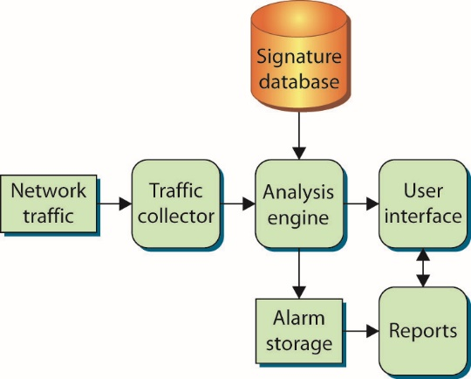
Figure 13.4 Network IDS components
Notes:
In general, most NIDSs operate in a fairly similar fashion. This figure shows the logical layout of a NIDS. By considering the function and activity of each component, you can gain some insight into how a NIDS operates.

Slide 24
Network-Based IDSs (continued)
NIDs major components include:
Traffic collector
Analysis engine
Reports
User interface
The NIDS signature database is usually much larger than that of a host-based system.
Using lessons learned from HIDS, NIDS developers modified the logical component design to distribute the user interface and reporting functions.
Notes:
In a NIDS, the traffic collector is specifically designed to pull traffic from the network. This component usually behaves in much the same way as a network traffic sniffer—it simply pulls every packet it can see off the network to which it is connected. In a NIDS, the traffic collector will logically attach itself to a network interface card (NIC) and instruct the NIC to accept every packet it can. A NIC that accepts and processes every packet regardless of the packet’s origin and destination is said to be in promiscuous mode.
The analysis engine in a NIDS serves the same function as its host-based counterpart, with some substantial differences. The network analysis engine must be able to collect packets and examine them individually or, if necessary, reassemble them into an entire traffic session. The patterns and signatures being matched are far more complicated than host-based signatures, so the analysis engine must be able to remember what traffic preceded the traffic currently being analyzed so that it can determine whether or not that traffic fits into a larger pattern of malicious activity. Additionally, the network-based analysis engine must be able to keep up with the flow of traffic on the network, rebuilding network sessions and matching patterns in real time.
The NIDS signature database is usually much larger than that of a host-based system. When examining network patterns, the NIDS must be able
to recognize traffic targeted at many different applications and operating systems as well as traffic from a wide variety of threats (worms, assessment tools, attack tools, and so on). Some of the signatures themselves can be quite large, as the NIDS must look at network traffic occurring in a specific order over a period of time to match a particular malicious pattern.

Slide 25
Network-Based IDSs (continued)
There was a need to handle multiple links in many different locations.
This issue was solved by dividing the components and assigning them to separate entities.
The traffic collector, analysis engine, and signature database were bundled into a single entity, usually called a sensor or appliance.
The sensors would report to and be controlled by a central system or master console.

Slide 26
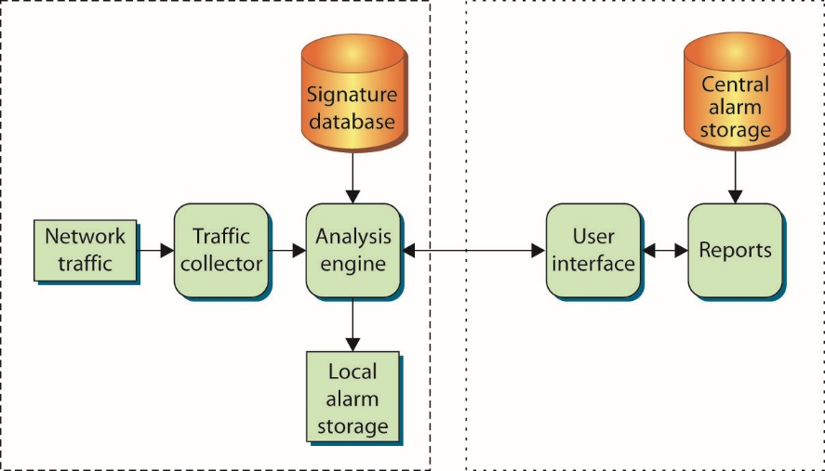
Figure 13.5 Distributed network IDS components
Notes:
This central system, shown in Figure 13.5, consolidated alarms and provided the user interface and reporting functions that allowed users in one location to manage, maintain, and monitor sensors deployed in a variety of remote locations.

Slide 27
Network-Based IDSs (continued)
By creating separate components designed to work together, the NIDS developers were able to build a more capable and flexible system.
With encrypted communications, network sensors could be placed around both local and remote perimeters and still be monitored and managed securely centrally.
Sensor placement quickly became an issue for most security personnel.
With firewalls present, location of the NIDS relative to the firewall had to be considered.
Notes:
By creating separate components designed to work together, the NIDS developers were able to build a more capable and flexible system. With encrypted communications, network sensors could be placed around both local and remote perimeters and still be monitored and managed securely from a central location. Placement of the sensors very quickly became an issue for most security personnel, as the sensors obviously had to have visibility of the network traffic in order to analyze it. Because most organizations with NIDSs also had firewalls, location of the NIDS relative to the firewall had to be considered as well.
Placed before the firewall, as shown in Figure 13.6, the NIDS will see all traffic coming in from the Internet, including attacks against the firewall itself. This includes traffic that the firewall stops and does not permit into the corporate network. With this type of deployment, the NIDS sensor will generate a large number of alarms (including alarms for traffic that the firewall would stop). This tends to overwhelm the human operators managing the system.

Slide 28
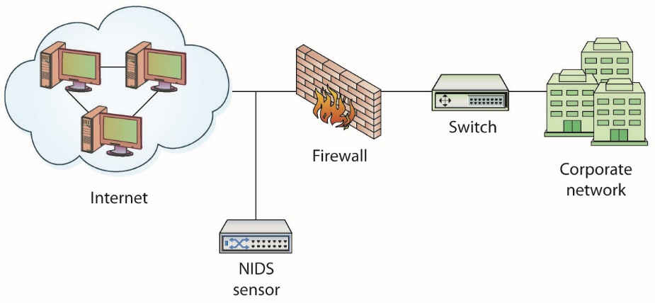
Figure 13.6 NIDS sensor placed in front of firewall
Notes:
Because most organizations with NIDSs also had firewalls, location of the NIDS relative to the firewall had to be considered as well.
Placed before the firewall, as shown in this figure, the NIDS will see all traffic coming in from the Internet, including attacks against the firewall itself. This includes traffic that the firewall stops and does not permit into the corporate network. With this type of deployment, the NIDS sensor will generate a large number of alarms (including alarms for traffic that the firewall would stop). This tends to overwhelm the human operators managing the system.

Slide 29
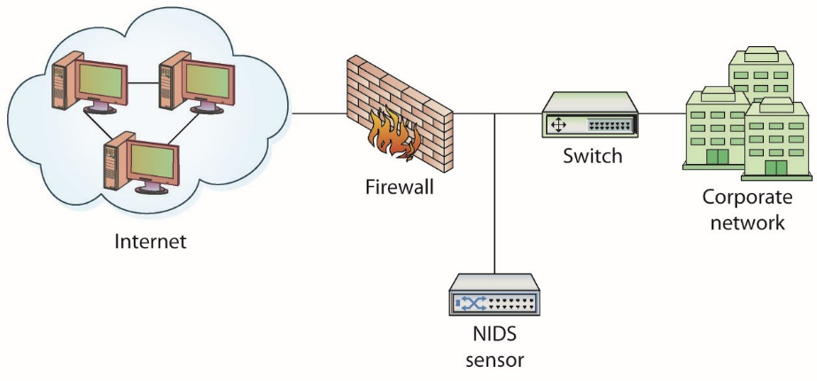
Figure 13.7 NIDS sensor placed behind firewall
Notes:
Placed after the firewall, as shown in Figure 13.7, the NIDS sensor sees and analyzes the traffic that is being passed through the firewall and into the corporate network. While this does not allow the NIDS to see attacks against the firewall, it generally results in far fewer alarms and is the most popular placement for NIDS sensors.

Slide 30
Network-Based IDSs (continued)
NIDSs examine the network traffic for suspicious or malicious activity.
Two examples illustrate the operation of NIDS:
Port scan – A port scan is a reconnaissance activity a potential attacker uses to find out information about the systems he wants to attack.
Ping of death – Certain operating systems could be crashed by sending a very large Internet Control Message Protocol (ICMP) echo request packet to that system.
Fairly simple traffic pattern for a NIDS to identify

Slide 31
Advantages of a NIDS
Providing IDS coverage requires fewer systems.
Deployment, maintenance, and upgrade costs are usually lower.
NIDS has visibility into all network traffic and can correlate attacks among multiple systems.
Notes:
A NIDS has certain advantages that make it a good choice for certain situations:
Providing IDS coverage requires fewer systems. With a few well-placed NIDS sensors, you can monitor all the network traffic going in and out of your organization. Fewer sensors usually equates to less overhead and maintenance, meaning you can protect the same number of systems at a lower cost.
Deployment, maintenance, and upgrade costs are usually lower. The fewer systems that have to be managed and maintained to provide IDS coverage, the lower the cost to operate the IDS. Upgrading and maintaining a few sensors is usually much cheaper than upgrading and maintaining hundreds of host-based processes.
A NIDS has visibility into all network traffic and can correlate attacks among multiple systems. Well-placed NIDS sensors can see the “big picture” when it comes to network-based attacks. The network sensors can tell you whether attacks are widespread and unorganized or focused and concentrated on specific systems.

Slide 32
Disadvantages of a NIDS
It is ineffective when traffic is encrypted.
It cannot see traffic that does not cross it.
It must be able to handle high volumes of traffic.
It does not know about activity on the hosts themselves.
Notes:
Disadvantages of a NIDS A NIDS has certain disadvantages:
It is ineffective when traffic is encrypted. When network traffic is encrypted from application to application or system to system, a NIDS sensor will not be able to examine that traffic. With the increasing popularity of encrypted traffic, this is becoming a bigger problem for effective IDS operations.
It can’t see traffic that does not cross it. The IDS sensor can examine only traffic crossing the network link it is monitoring. With most IDS sensors being placed on perimeter links, traffic traversing the internal network is never seen.
It must be able to handle high volumes of traffic. As network speeds continue to increase, the network sensors must be able to keep pace and examine the traffic as quickly as it can pass the network. When NIDSs were introduced, 10-Mbps networks were the norm. Now 100-Mbps and even 1-Gbps networks are commonplace. This increase in traffic speeds means IDS sensors must be faster and more powerful than ever before.
It doesn’t know about activity on the hosts themselves. NIDSs focus on network traffic. Activity that occurs on the hosts themselves will not be seen by a NIDS.

Slide 33
Active vs. Passive NIDSs
Passive NIDS
Simply watches traffic, analyzes it, and generates alarms
Does not interact with the traffic itself
Does not modify the defensive posture of the system to react to the traffic
Active NIDS
Contains all the same components and capabilities of the passive NIDS
Can react to the traffic it is analyzing
Notes:
Most NIDSs can be distinguished by how they examine the traffic and whether or not they interact with that traffic.
On a passive system, the NIDS simply watches the traffic, analyzes it, and generates alarms. It does not interact with the traffic itself in any way, and it does not modify the defensive posture of the system to react to the traffic. A passive NIDS is very similar to a simple motion sensor—it generates an alarm when it matches a pattern, much as the motion sensor generates an alarm when it sees movement.
An active NIDS contains all the same components and capabilities of the passive NIDS with one critical addition—the active NIDS can react to the traffic it is analyzing. These reactions can range from something simple, such as sending a TCP reset message to interrupt a potential attack and disconnect a session, to something complex, such as dynamically modifying firewall rules to reject all traffic from specific source IP addresses for the next 24 hours.

Slide 34
NIDS Tools
Snort has been the de facto standard IDS engine since its creation in 1998.
It has a large user base and set the standard for many IDS element, including rule sets and formats.
Suricata is an open source IDS, begun with grant money from the U.S. government and maintained by the Open Source Security Foundation (OSIF).
Has one advantage over Snort – supports multithreading.
Both systems are highly flexible and scalable, operating on both Windows and Linux platforms.
Notes:
Snort has been the de facto standard IDS engine since its creation in 1998. It has a large user base and set the standard for many IDS element, including rule sets and formats. Snort rules are the list of activities that Snort will alert on and provide the flexible power behind the IDS platform. Snort rule sets are updated by a large active community as well as Sourcefire Vulnerability Research Team, the company behind Snort. Snort VRT rule sets are available to subscribers and provide such elements as same-day protection for items such as Microsoft patch Tuesday vulnerabilities. These rules are moved to the open community after 30 days.
A newer entrant to the IDS marketplace is Suricata. Suricata is an open source IDS, begun with grant money from the U.S. government and maintained by the Open Source Security Foundation (OSIF). Suricata has one advantage over Snort: it supports multithreading, while Snort only supports single-threaded operation.

Slide 35
Host-Based IDSs
Host-based IDS (HIDS)
Examines log files, audit trails, and network traffic coming into or leaving a specific host
Operate in real time, looking for activity as it occurs, or in batch mode, looking for activity on a periodic basis
Typically self-contained
Take local system resources to operate
Focus on the log files or audit trails generated by the local operating system
Some cover specific applications (FTP or web services)
Notes:
Most HIDSs focus on the log files or audit trails generated by the local operating system. On UNIX systems, the examined logs usually include those created by syslog, such as messages, kernel logs, and error logs. On Windows systems, the examined logs are typically the three event logs: Application, System, and Security.
Some HIDSs can cover specific applications, such as FTP or web services, by examining the logs produced by those specific applications or examining the traffic from the services themselves.

Slide 36
Host-Based IDSs (continued)
Within the log files, the HIDS is looking for certain activities that typify hostile actions or misuse:
Logins at odd hours
Login authentication failures
Additions of new user accounts
Modification or access of critical system files
Modification or removal of binary files (executables)
Starting or stopping processes
Privilege escalation
Use of certain programs
Notes:
Within the log files, the HIDS is looking for certain activities that typify hostile actions or misuse, such as the following:
Logins at odd hours
Login authentication failures
Additions of new user accounts
Modification or access of critical system files
Modification or removal of binary files (executables)
Starting or stopping processes
Privilege escalation
Use of certain programs

Slide 37
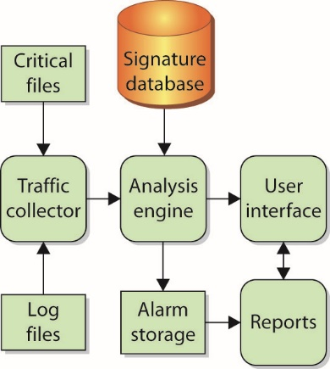
Figure 13.8 Host-based IDS components
Notes:
In general, most HIDSs operate in a very similar fashion. This figure shows the logical layout of a HIDS. By considering the function and activity of each component, you can gain some insight into how HIDSs operate.

Slide 38
Host-Based IDSs (continued)
HIDS components
Traffic collector – pulls in the information the other components, such as the analysis engine
Analysis engine mechanism – looks at the information provided by the traffic collector and tries to match it against known patterns of activity stored in the signature database
Signature database – a collection of predefined activity patterns that have already been identified and categorized
User interface – part that humans interact with
Notes:
As on any IDS, the traffic collector on a HIDS pulls in the information the other components, such as the analysis engine, need to examine. For most HIDSs, the traffic collector pulls data from information the local system has already generated, such as error messages, log files, and system files. The traffic collector is responsible for reading those files, selecting which items are of interest, and forwarding them to the analysis engine. On some HIDSs, the traffic collector also examines specific attributes of critical files, such as file size, date modified, or checksum.
The analysis engine is perhaps the most important component of the HIDS, as it must decide what activity is “okay” and what activity is “bad.” The analysis engine is a sophisticated decision and pattern-matching mechanism—it looks at the information provided by the traffic collector and tries to match it against known patterns of activity stored in the signature database. If the activity matches a known pattern, the analysis engine can react, usually by issuing an alert or alarm. An analysis engine may also be capable of remembering how the activity it is looking at right now compares to traffic it has already seen or may see in the near future, so that it can match more complicated, multistep malicious activity patterns. An analysis engine must also be capable of examining traffic patterns as quickly as possible, as the longer it takes to match a malicious pattern, the less time the HIDS or human operator has to react to malicious traffic. Most HIDS vendors build a decision tree into their analysis engines to expedite pattern matching.
The signature database is a collection of predefined activity patterns that have already been identified and categorized—patterns that typically indicate suspicious or malicious activity. When the analysis engine has an activity or traffic pattern to examine, it compares that pattern to the appropriate signatures in the database. The signature database can contain anywhere from a few to a few thousand signatures, depending on the vendor, type of HIDS, space available on the system to store signatures, and other factors.
The user interface is the visible component of the HIDS—the part that humans interact with. The user interface varies widely depending on the product and vendor and could be anything from a detailed GUI to a simple command line. Regardless of the type and complexity, the interface is provided to allow the user to interact with the system: changing parameters, receiving alarms, tuning signatures and response patterns, and so on.

Slide 39
Advantages of HIDSs
Very operating system–specific with more detailed signatures
Reduce false-positive rates
Examine data after it has been decrypted
Very application specific
Determine whether or not an alarm may impact that specific system
Notes:
HIDSs have certain advantages that make them a good choice for certain situations:
They can be very operating system–specific and have more detailed signatures. A HIDS can be very specifically designed to run on a certain operating system or to protect certain applications. This narrow focus lets developers concentrate on the specific things that affect the specific environment they are trying to protect. With this type of focus, the developers can avoid generic alarms and develop much more specific, detailed signatures to identify malicious traffic more accurately.
They can reduce false-positive rates. When running on a specific system, the HIDS process is much more likely to be able to determine whether or not the activity being examined is malicious. By more accurately identifying which activity is “bad,” the HIDS will generate fewer false positives (alarms generated when the traffic matches a pattern but is not actually malicious).
They can examine data after it has been decrypted. With security concerns constantly on the rise, many developers are starting to encrypt their network communications. When designed and implemented in the right manner, a HIDS will be able to examine traffic that is unreadable to a network-based IDS. This particular ability is becoming more important each day as more and more web sites start to encrypt all of their traffic.
They can be very application specific. On a host level, the IDS can be designed, modified, or tuned to work very well on specific applications without having to analyze or even hold signatures for other applications that are not running on that particular system. Signatures can be built for specific versions of web server software, FTP servers, mail servers, or any other application housed on that host.
They can determine whether or not an alarm may impact that specific system. The ability to determine whether or not a particular activity or pattern will really affect the system being protected assists greatly in reducing the number of generated alarms. Because the HIDS resides on the system, it can verify things such as patch levels, presence of certain files, and system state when it analyzes traffic. By knowing what state the system is in, the HIDS can more accurately determine whether an activity is potentially harmful to the system.

Slide 40
Disadvantages of HIDSs
Must have a process on every system you want to watch
High cost of ownership and maintenance
Uses local system resources
Very focused view and cannot relate to activity around it
If logging only locally, could be compromised or disabled
Notes:
HIDSs also have certain disadvantages that must be weighed in making the decision of whether to deploy this type of technology:
The HIDS must have a process on every system you want to watch. You must have a HIDS process or application installed on every host you want to watch. To watch 100 systems, then, you would need to deploy 100 HIDSs, or remote agents.
The HIDS can have a high cost of ownership and maintenance. Depending on the specific vendor and application, a HIDS can be fairly costly in terms of time and manpower to maintain. Unless some type of central console is used that allows you to maintain remote processes, administrators must maintain each HIDS process individually. Even with a central console, with a HIDS, there will be a high number of processes to maintain, software to update, and parameters to tune.
The HIDS uses local system resources. To function, the HIDS must use CPU cycles and memory from the system it is trying to protect. Whatever resources the HIDS uses are no longer available for the system to perform its other functions. This becomes extremely important on applications such as high-volume web servers, where fewer resources usually means fewer visitors served and the need for more systems to handle expected traffic.
The HIDS has a very focused view and cannot relate to activity around it. The HIDS has a limited view of the world, as it can see activity only on the host it is protecting. It has little to no visibility into traffic around it on the network or events taking place on other hosts. Consequently, a HIDS can tell you only if the system it is running on is under attack.
The HIDS, if logging only locally, could be compromised or disabled. When a HIDS generates alarms, it typically stores the alarm information in a file or database of some sort. If the HIDS stores its generated alarm traffic on the local system, an attacker that is successful in breaking into the system may be able to modify or delete those alarms. This makes it difficult for security personnel to discover the intruder and conduct any type of post-incident investigation. A capable intruder may even be able to turn off the HIDS process completely.

Slide 41
Active vs. Passive HIDSs
Passive HIDS
Simply watches the activity, analyzes it, and generates alarms
Does not interact with the activity itself in any way
Does not modify the defensive posture of the system to react to the traffic
Active HIDS
Contain all components and capabilities of the passive IDs
Can react to the activity it is analyzing
Notes:
Most IDSs can be distinguished by how they examine the activity around them and whether or not they interact with that activity. This is certainly true for HIDSs. On a passive system, the HIDS is exactly that—it simply watches the activity, analyzes it, and generates alarms. It does not interact with the activity itself in any way, and it does not modify the defensive posture of the system to react to the traffic. A passive HIDS is similar to a simple motion sensor—it generates an alarm when it matches a pattern, much as the motion sensor generates an alarm when it sees movement.
An active IDS will contain all the same components and capabilities of the passive IDS with one critical exception—the active IDS can react to the activity it is analyzing. These reactions can range from something simple, such as running a script to turn a process on or off, to something as complex as modifying file permissions, terminating the offending processes, logging off specific users, and reconfiguring local capabilities to prevent specific users from logging in for the next 12 hours.

Slide 42
Resurgence and Advancement of HIDSs
The past few years have seen a strong resurgence in the use of HIDSs.
The latest generation of HIDSs has introduced new capabilities designed to stop attacks by preventing them from ever executing or accessing protected files in the first place.
Does not rely on a specific signature set that only matches known attacks

Slide 43
Resurgence and Advancement of HIDSs (continued)
Modern HIDS is often referred to as host-based intrusion prevention systems (HIPS).
HIPS use the following components to prevent attacks:
Integrated system firewall
Behavioral- and signature-based IDS
Application control
Enterprise management
Malware detection and prevention
Notes:
The latest generation of HIDSs has introduced new capabilities designed to stop attacks by preventing them from ever executing or accessing protected files in the first place, rather than relying on a specific signature set that only matches known attacks.
The more advanced host-based offerings, which most vendors refer to as host-based intrusion prevention systems (HIPSs), combine the following elements into a single package:
Integrated system firewall – The firewall component checks all network traffic passing into and out of the host. Users can set rules for what types of traffic they want to allow into or out of their system.
Behavioral- and signature-based IDS – This hybrid approach uses signatures to match well-known attacks and generic patterns for catching “zero-day” or unknown attacks for which no signatures exist.
Application control – This allows administrators to control how applications are used on the system and whether or not new applications can be installed. Controlling the addition, deletion, or modification of existing software can be a good way to control a system’s baseline and prevent malware from being installed.
Enterprise management – Some host-based products are installed with an “agent” that allows them to be managed by and report back to a central server. This type of integrated remote management capability is essential in any large-scale deployment of host-based IDS/IPS.
Malware detection and prevention – Some HIDSs/HIPSs include scanning and prevention capabilities that address spyware, malware, rootkits, and other malicious software.

Slide 44
Intrusion Prevention Systems
An intrusion prevention system (IPS) monitors network traffic for malicious or unwanted behavior and can block, reject, or redirect that traffic in real time.
IPSs have an internal signature database to compare network traffic against known “bad” traffic patterns.
IPSs can perform content-based inspections.
Some IPSs can perform protocol inspection.
IPS can detect and defeat popular evasion techniques such as encoding URLs.

Slide 45
Intrusion Prevention Systems (continued)
Unlike a traditional IDS, an IPS must sit inline (in the flow of traffic) to be able to interact effectively with the network traffic.
Like a traditional IDS, the IPS has a potential weakness when dealing with encrypted traffic.
IPSs (and IDSs) often marketed by the amount of traffic they can process without dropping packets or interrupting the flow of network traffic.
In reality, a network never reach its hypothetical maximum transmission rate, or wire speed.

Slide 46
Honeypots and Honeynets
A honeypot, sometimes called a digital sandbox, is an artificial environment where attackers can be contained and observed without putting real systems at risk.
Appears to an attacker to be a real network
Activity recorded for later analysis
Afford information and additional security but require significant time, cost and effort to maintain
A honeynet is a collection of two or more honeypots.
Notes:
Exam Tip: A honeypot is a system designed to attract potential attackers by pretending to be one or more systems with open network services.
As is often the case, one of the best tools for information security personnel has always been knowledge. To secure and defend a network and the information systems on that network properly, security personnel need to know what they are up against. What types of attacks are being used? What tools and techniques are popular at the moment? How effective is a certain technique? What sort of impact will this tool have on my network? Often this sort of information is passed through white papers, conferences, mailing lists, or even word of mouth. In some cases, the tool developers themselves provide much of the information in the interest of promoting better security for everyone.
Information is also gathered through examination and forensic analysis, often after a major incident has already occurred and information systems are already damaged. One of the most effective techniques for collecting this type of information is to observe activity firsthand—watching an attacker as he probes, navigates, and exploits his way through a network. To accomplish this without exposing critical information systems, security researchers often use something called a honeypot.
Larger, very diverse network environments can deploy multiple honeypots (thus forming a honeynet) when a single honeypot device does not provide enough coverage. Honeynets are often integrated into an organization-wide IDS/IPS because the honeynet can provide relevant information about potential attackers.

Slide 47
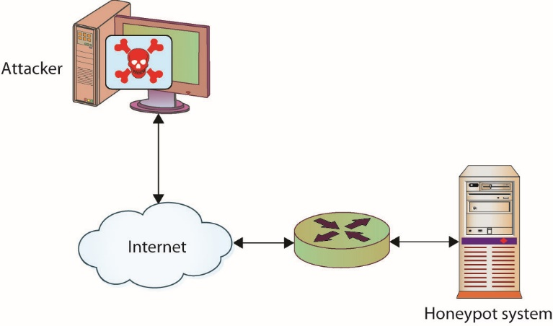
Figure 13.9 Logical depiction of a honeypot
Notes:
A good honeypot appears to an attacker to be a real network consisting of application servers, user systems, network traffic, and so on, but in most cases it’s actually made up of one or a few systems running specialized software to simulate the user and network traffic common to most targeted networks. This figure illustrates a simple honeypot layout in which a single system is placed on the network to deliberately attract attention from potential attackers.
This figure shows the security researcher’s view of the honeypot.

Slide 48
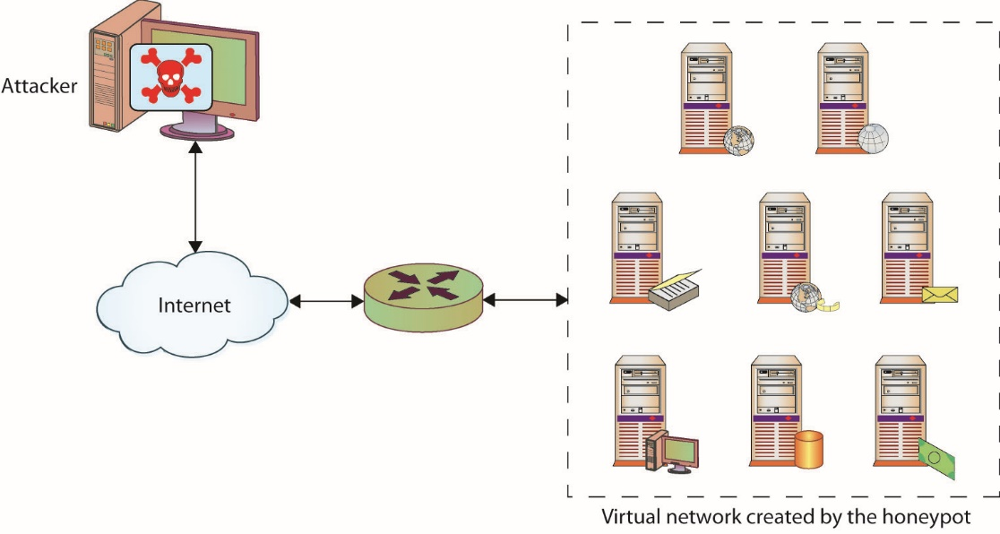
Figure 13.10 Virtual network created by the honeypot
Notes:
This figure shows the attacker’s view of a honeypot.

Slide 49
Tools
Tools are a vital part of any security professional’s skill set.
Tools can be used for internal assessment activities, tracking down infected systems, spotting inappropriate behavior, and so on.
Knowing the right tool for the job can be critical to performing effectively.

Slide 50
Protocol Analyzer
A protocol analyzer (also known as a packet sniffer, network analyzer, or network sniffer) is a piece of software or an integrated software/hardware system that can capture and decode network traffic.
They have been popular with system administrators and security professionals for decades because they are such versatile and useful tools for a network environment.

Slide 51
Protocol Analyzer (continued)
Protocol analyzers can be used for several activities:
Detecting intrusions or undesirable traffic (an IDS/IPS must have some type of capture and decode ability to be able to look for suspicious/malicious traffic)
Capturing traffic during incident response or incident handling
Looking for evidence of botnets, Trojans, and infected systems
Looking for unusual traffic or traffic exceeding certain thresholds
Testing encryption between systems or applications

Slide 52
Protocol Analyzer (continued)
From a network administration perspective, protocol analyzers can be used for activities such as these:
Analyzing network problems
Detecting misconfigured applications or misbehaving applications
Gathering and reporting network usage and traffic statistics
Debugging client/server communications

Slide 53
Protocol Analyzer (continued)
A protocol analyzer must be able to see network traffic in order to capture and decode it.
A software-based protocol analyzer must be able to place the NIC it is going to use to monitor network traffic in promiscuous mode (sometimes called promisc mode).
With switches now the standard for networking equipment, placing a protocol analyzer becomes more difficult as switches do not broadcast every packet across every port.
Notes:
Promiscuous mode tells the NIC to process every network packet it sees regardless of the intended destination. Normally, a NIC processes only broadcast packets (which go to everyone on that subnet) and packets with the NIC’s Media Access Control (MAC) address as the destination address inside the packet. As a sniffer, the analyzer must process every packet crossing the wire, so the ability to place a NIC into promiscuous mode is critical.
With older networking technologies, such as hubs, it was easier to operate a protocol analyzer, as the hub broadcasted every packet across every interface regardless of the destination. With switches now the standard for networking equipment, placing a protocol analyzer becomes more difficult as switches do not broadcast every packet across every port. While this may make it harder for administrators to sniff the traffic, it also makes it harder for eavesdroppers and potential attackers.

Slide 54
Protocol Analyzer (continued)
To accommodate protocol analyzers, IDS devices, and IPS devices, most switch manufacturers support port mirroring or a Switched Port Analyzer (SPAN) port.
Another option for traffic capture is to use a network tap.
A hardware device that can be placed inline on a network connection and that will copy traffic passing through the tap to a second set of interfaces on the tap
Notes:
Depending on the manufacturer and the hardware, a mirrored port will see all the traffic passing through the switch or through a specific VLAN(s), or all the traffic passing through other specific switch ports. The network traffic is essentially copied (or mirrored) to a specific port, which can then support a protocol analyzer.
Another option for traffic capture is to use a network tap, a hardware device that can be placed inline on a network connection and that will copy traffic passing through the tap to a second set of interfaces on the tap. Network taps are often used to sniff traffic passing between devices at the network perimeter, such as the traffic passing between a router and a firewall.

Slide 55
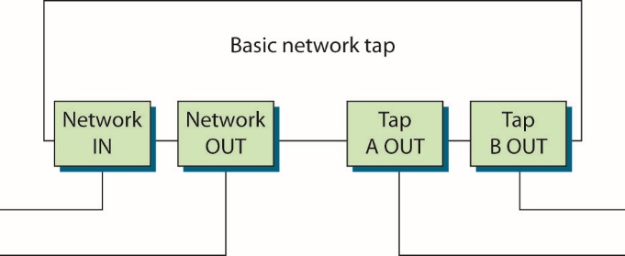
Figure 13.11 A basic network tap
Notes:
Many common network taps work by bridging a network connection and passing incoming traffic out one tap port (A) and outgoing traffic out another tap port (B), as shown in this figure.

Slide 56
Protocol Analyzer (continued)
Wireshark is a popular, open source protocol.
Available for both UNIX and Windows operating systems
GUI-based protocol analyzer
Can capture and decode network traffic on any available network interface in the system on which the software is running (including wireless interfaces),
Includes the ability to “follow the TCP stream” and then see all the other packets involved in that TCP conversation

Slide 57
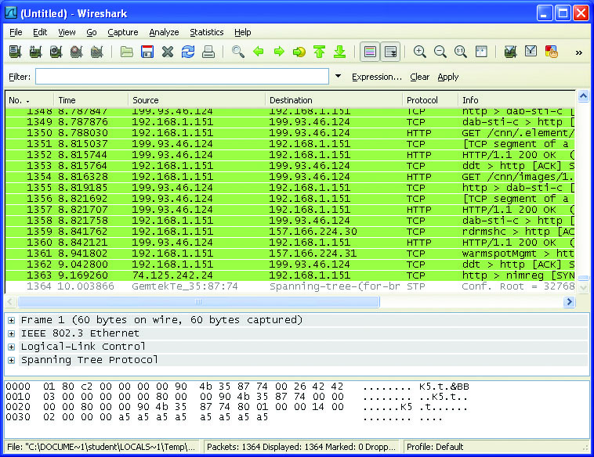
Figure 13.12 Wireshark—a popular, open source protocol analyzer
Notes:
Wireshark is a GUI-based protocol analyzer that allows users to capture and decode network traffic on any available network interface in the system on which the software is running (including wireless interfaces), as demonstrated in this figure.

Slide 58
Switched Port Analyzer
The term Switched Port Analyzer (SPAN) is usually associated with Cisco switches—other vendors refer to the same capability as port mirroring or port monitoring.
A SPAN has the ability to copy network traffic passing through one or more ports on a switch or one or more VLANs on a switch and forward that copied traffic to a port designated for traffic capture and analysis
When configuring port mirroring, you need to be aware of the capabilities of the switch with which you are working.
Notes:
A SPAN port or mirror port creates the collection point for traffic that will be fed into a protocol analyzer or IDS/IPS. SPAN or mirror ports can usually be configured to monitor traffic passing into interfaces, passing out of interfaces, or passing in both directions. When configuring port mirroring, you need to be aware of the capabilities of the switch you are working with.

Slide 59
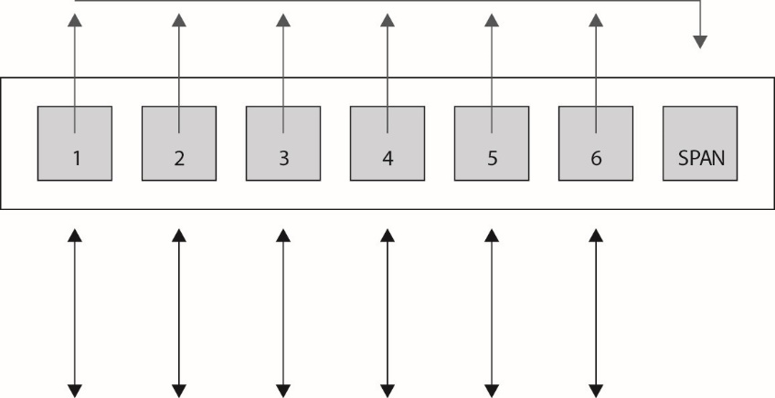
Figure 13.13 A SPAN port collects traffic from other ports on a switch.
Notes:
A SPAN has the ability to copy network traffic passing through one or more ports on a switch or one or more VLANs on a switch and forward that copied traffic to a port designated for traffic capture and analysis as shown in this figure.

Slide 60
Port Scanner
A port scanner is a tool designed to probe a system or systems for open ports.
Its job is to probe for open (or listening) ports and report back to the user which ports are closed, which are filtered, and which are open.
Port scanners are available for virtually every operating system and almost every popular mobile computing platform.

Slide 61
Port Scanner (continued)
Port scanners can be used to:
Search for “live” hosts on a network
Search for any open ports on the network
Search for specific ports
Identify services on ports
Look for TCP/UDP services
Security professionals use them in much the same way an attacker would: to probe the systems in your network for open services.
Notes:
Port scanners can be used to do the following:
Search for “live” hosts on a network. Most port scanners enable you to perform a quick scan using ICMP, TCP, or UDP packets to search for active hosts on a given network or network segment. ICMP is still very popular for this task, but with the default blocking of ICMP v4 in many modern operating systems, such as Windows 7 and beyond, users are increasingly turning to TCP or UDP scans for these tasks.
Search for any open ports on the network. Port scanners are most often used to identify any open ports on a host, group of hosts, or network. By scanning a large number of ports over a large number of hosts, a port scanner can provide you (or an attacker) with a very good picture of what services are running on which hosts on your network. Scans can be done for the “default” set of popular ports, a large range of ports, or every possible port (from 1 to 65535).
Search for specific ports. Only looking for web servers? Mail servers? Port scanners can also be configured to just look for specific services.
Identify services on ports. Some port scanners can help identify the services running on open ports based on information returned by the service or the port/service assigned (if standards have been followed). For example, a service running on port 80 is likely to be a web server.
Look for TCP/UDP services. Most port scanners can perform scans for both TCP and UDP services, although some tools do not allow you to scan for both protocols at the same time.
As a security professional, you’ll use port scanners in much the same way an attacker would: to probe the systems in your network for open services. When you find open services, you’ll need to determine if those services should be running at all, if they should be running on the system(s) you found them on, and if you can do anything to limit what connections are allowed to those services. For example, you may want to scan your network for any system accepting connections on TCP port 1433 (Microsoft SQL Server). If you find a system accepting connections on TCP port 1433 in your Sales group, chances are someone has installed something they shouldn’t have (or someone installed something for them).

Slide 62
Port Scanner (continued)
By examining the responses from each port, you can typically deduce a bit more information about the system(s) you are scanning.
Open – Open ports accept connections.
Closed – Typically see this response when the scanned target returns an RST packet.
Filtered – Typically see this response when an ICMP unreachable error is returned.
Additional types – Some port scanners will attempt to further classify responses, such as dropped, blocked, denied, timeout, and so on.

Slide 63
Port Scanner (continued)
Defending against port scans is tough.
You can block IP addresses that scan you.
Most organizations do not because you run the risk of an attacker spoofing source addresses as decoys for other scanning activity.
The best defense is to carefully control what traffic you let in and out of your network, using firewalls, network filters, and host filters.
Carefully monitor any traffic allowed into the network

Slide 64
Passive vs. Active Tools
Active tools interact with a target system in a fashion where their use can be detected.
Scanning a network with Nmap (Network Mapper) is an active act that can be detected.
Passive tools are those that do not interact with the system in a manner that would permit detection, as in sending packets or altering traffic.
Examples include Tripwire and OS mapping by analyzing TCP/IP traces with a tool such as Wireshark.
They can use existing traffic to provide data for analysis.
Notes:
Active tools interact with a target system in a fashion where their use can be detected. Scanning a network with Nmap (Network Mapper) is an active act that can be detected. In the case of Nmap, the tool may not be specifically detectable, but its use, the sending of packets, can be detected. When you need to map out your network or look for open services on one or more hosts, a port scanner is probably the most efficient tool for the job.
Passive tools are those that do not interact with the system in a manner that would permit detection, as in sending packets or altering traffic. An example of a passive tool is Tripwire, which can detect changes to a file based on hash values. Another passive example is the OS mapping by analyzing TCP/IP traces with a tool such as Wireshark. Passive sensors can use existing traffic to provide data for analysis.

Slide 65
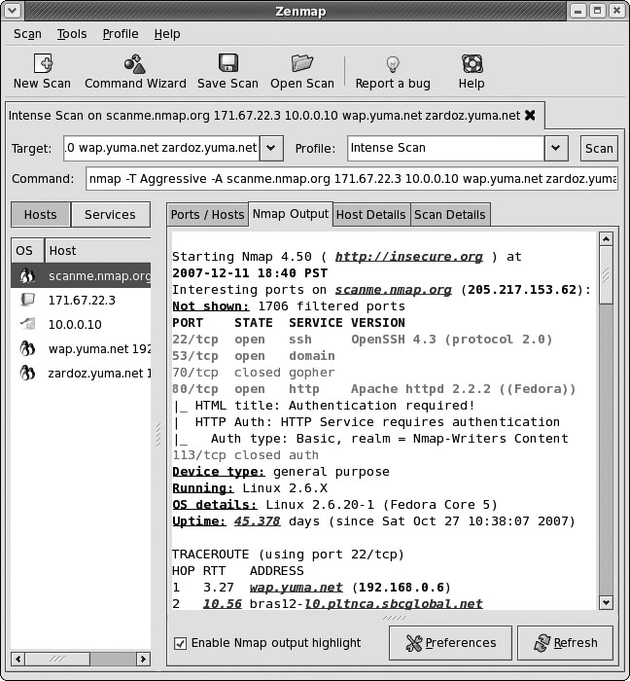
Figure 13.14 Zenmap—a port scanner based on Nmap
Notes:
Figure 13.14 shows a screen shot of Zenmap, a cross-platform version of the very popular Nmap port scanner available from http://insecure.org.

Slide 66
Banner Grabbing
Banner grabbing is a technique used to gather information from a service that publicizes information via a banner.
Banners can be used for many things.
Identify services by type, version, and so forth
Enable administrators to post information, including warnings, to users when they log in
Attackers determine services running
Notes:
Attackers can use banners to determine what services are running, and typically do for common banner issuing services such as HTTP, FTP, SMTP, and Telnet.

Slide 67
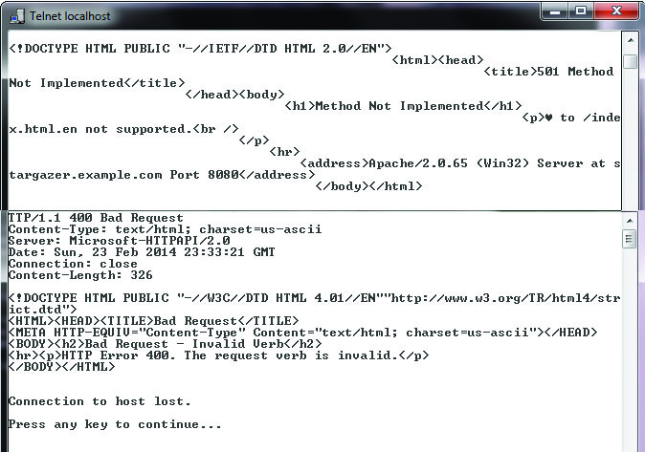
Figure 13.15 Banner grabbing using Telnet
Notes:
This figure shows a couple of banner grabs being performed from a Telnet client against a web server. In this example, Telnet sends information to two different web servers and displays the responses (the banners). The top response is from an Apache instance (Apache/2.0.65) and the bottom is from Microsoft IIS (Microsoft-HTTPAPI/2.0).

Slide 68
Chapter Summary
Apply the appropriate network tools to facilitate network security.
Determine the appropriate use of tools to facilitate network security.
Apply host-based security applications.

